Slide 1
Leveraging the BI Features in Excel 2016
Notes:
This module begins with an overview of the enhancements and BI support in Microsoft Excel 2016 along with a discussion of its strengths and weaknesses when compared to Power Bi Desktop. Students will learn how to use the enhanced support in Excel 2016 for Power Query, PowerPivot and the DAX language. The module also includes a discussion of creating charts and graphs on top of an excel data model as well as common practices in creating Excel workbooks which provides interactive dashboards.

Slide 2
Agenda
Data Model Support in Excel 2016
Power Query Support in Excel 2016
Power Pivot Support in Excel 2016
Creating Graphs and Charts from a Data Model
Publishing Excel Workbooks to Excel Online

Slide 3
Revisiting The Excel Data Model
Every Excel Workbook can have a data model
Provides a foundation for BI project solution
When importing data with Power Query…
You can add the data as a table in a worksheet
You can add the data as a table in the data model
Excel Workbook
worksheet
Database
worksheet
worksheet

Slide 4
Agenda
Data Model Support in Excel 2016
Power Query Support in Excel 2016
Power Pivot Support in Excel 2016
Creating Graphs and Charts from a Data Model
Publishing Excel Workbooks with Data Models

Slide 5
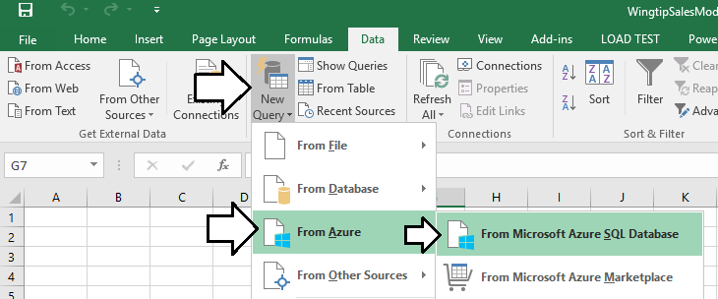
Working with the Power Query Add-In
Power Query Add-In adds a tab to Excel ribbon
Click Manage button display Power Query window
You must switch back and forth between Excel application window

Slide 6
Working with Power Query in Excel 2016

Slide 7
Agenda
Data Model Support in Excel 2016
Power Query Support in Excel 2016
Power Pivot Support in Excel 2016
Creating Graphs and Charts from a Data Model
Publishing Excel Workbooks with Data Models

Slide 8
Working with Power Pivot in Excel 2016

Slide 9
Agenda
Data Model Support in Excel 2016
Power Query Support in Excel 2016
Power Pivot Support in Excel 2016
Creating Graphs and Charts from a Data Model
Publishing Excel Workbooks with Data Models

Slide 10
Creating Excel PivotTables from a Data Model

Slide 11
Agenda
Data Model Support in Excel 2016
Power Query Support in Excel 2016
Power Pivot Support in Excel 2016
Creating Graphs and Charts from a Data Model
Publishing Excel Workbooks with Data Models

Slide 12
Publishing an Excel workbook with a Data Model

Slide 13
Summary
Data Model Support in Excel 2016
Power Query Support in Excel 2016
Power Pivot Support in Excel 2016
Creating Graphs and Charts from a Data Model
Publishing Excel Workbooks with Data Models

Slide 14
Working with Power Pivot in Excel 2016

